Slide 1
Online Membership
Paul Plate’

Slide 2


Slide 3



Why join online?
Convenience
Accuracy
Instantaneous

Slide 4
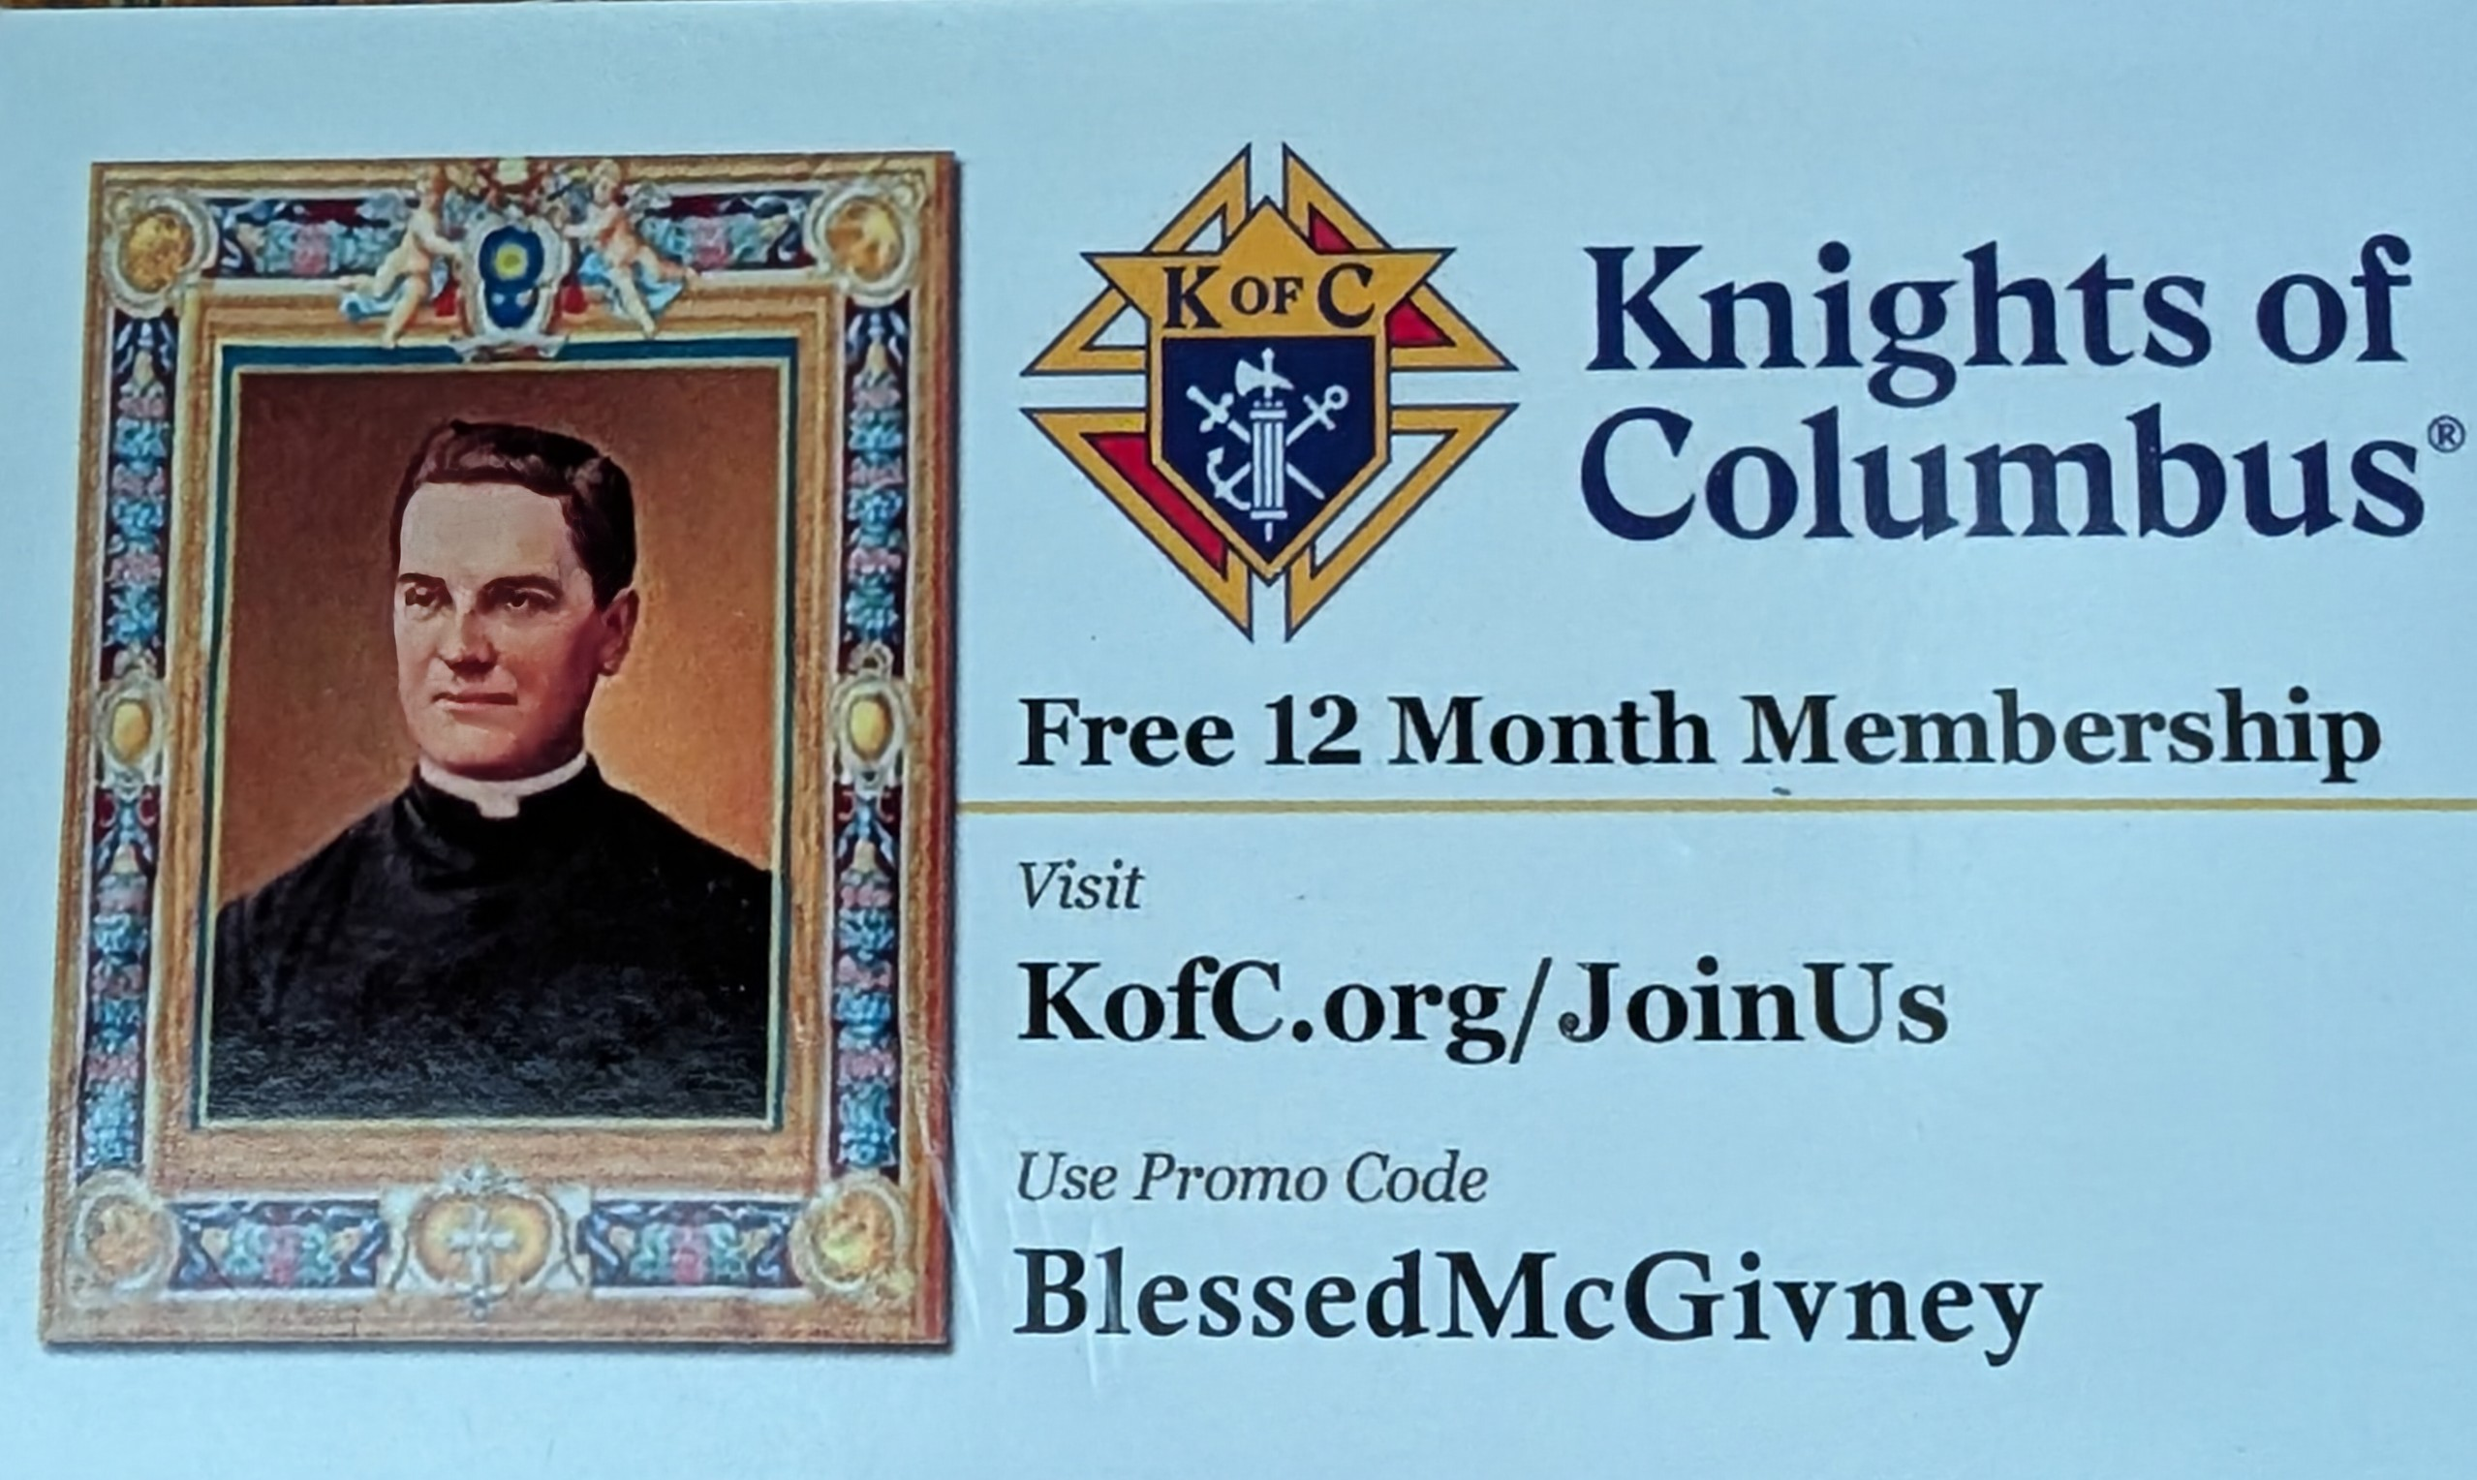
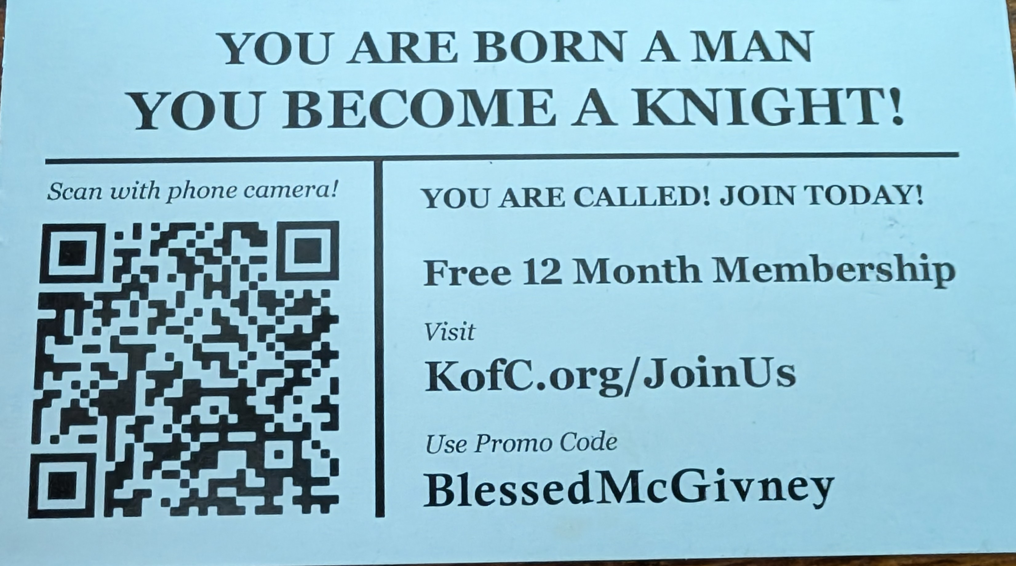
KofC.org/joinus

Slide 5
Online Membership Application Walk-through
www.kofc.org › online-membership-application-walkthrough

Slide 6
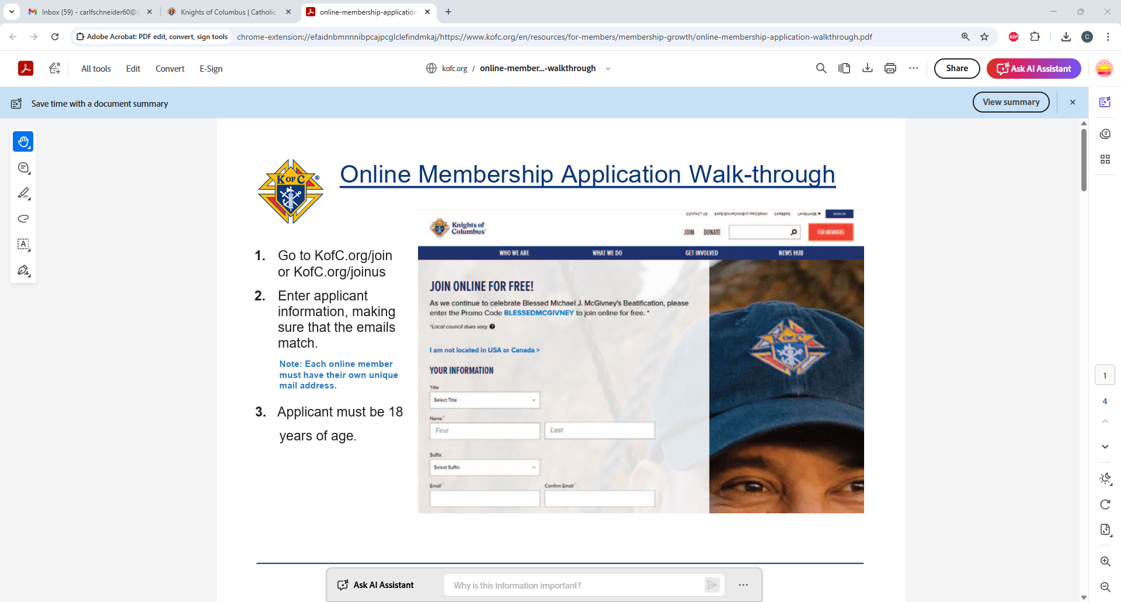

Slide 7
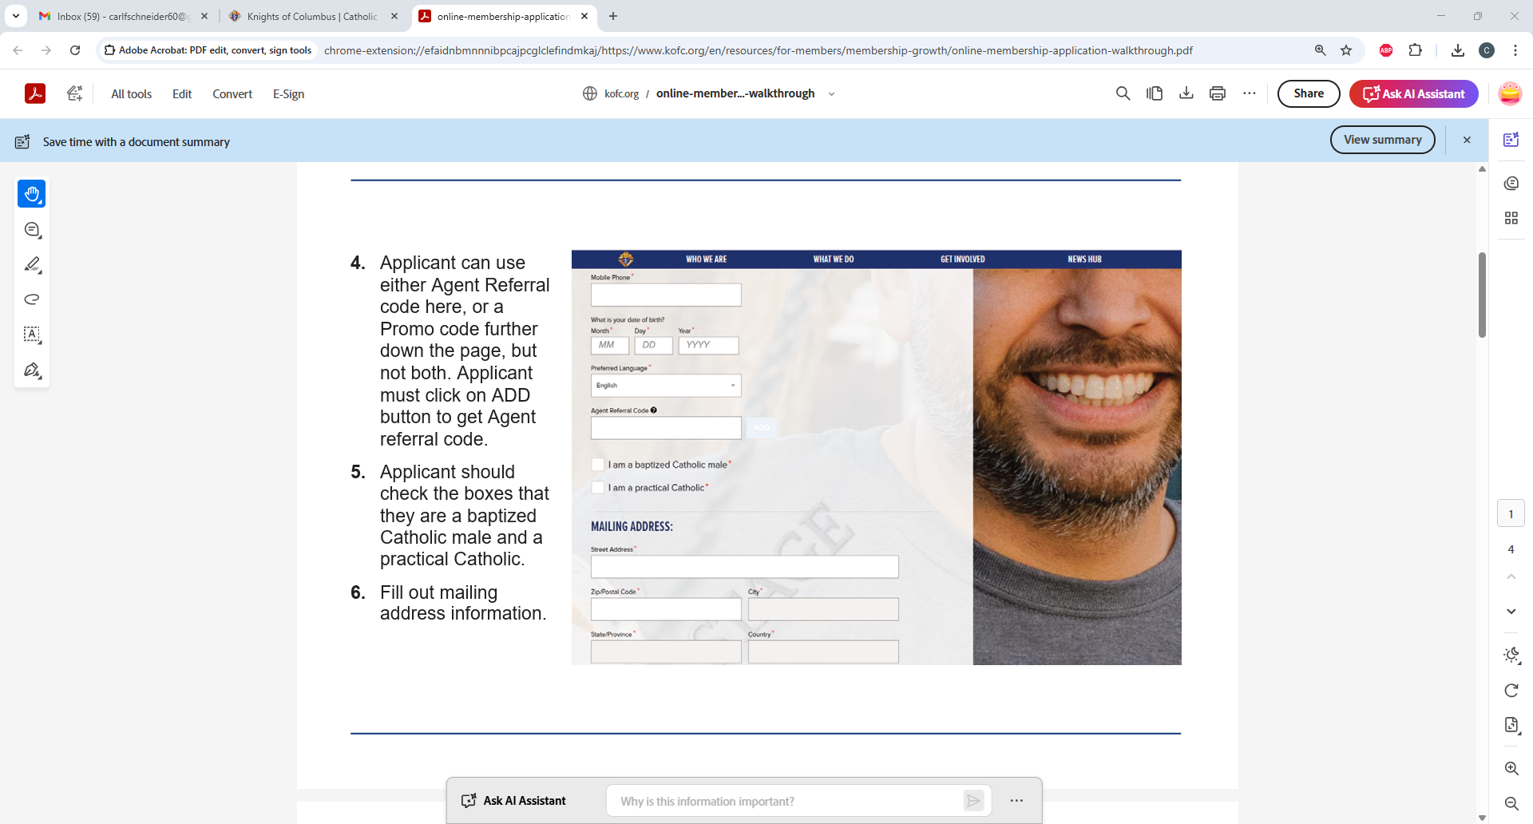

Slide 8
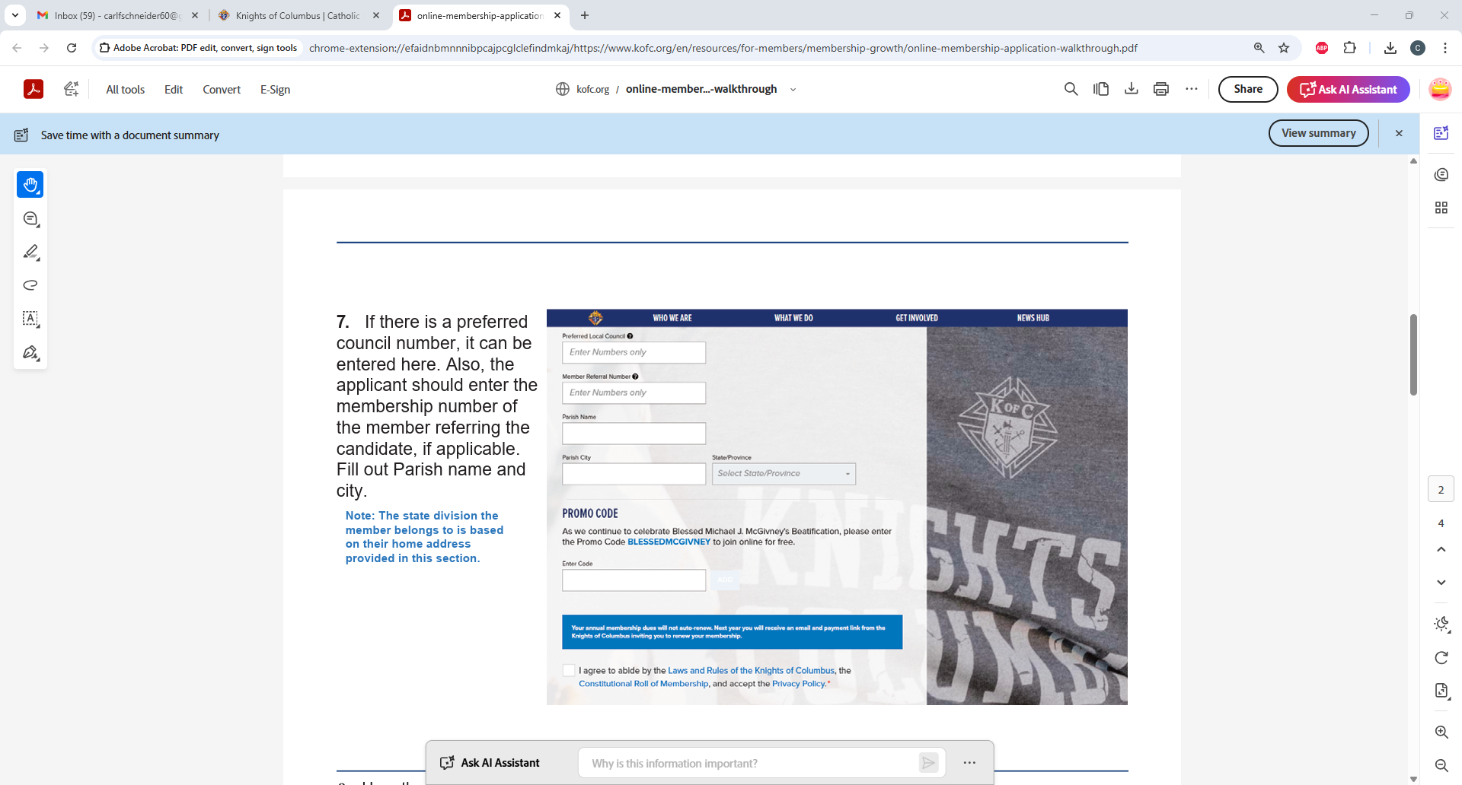

Slide 9
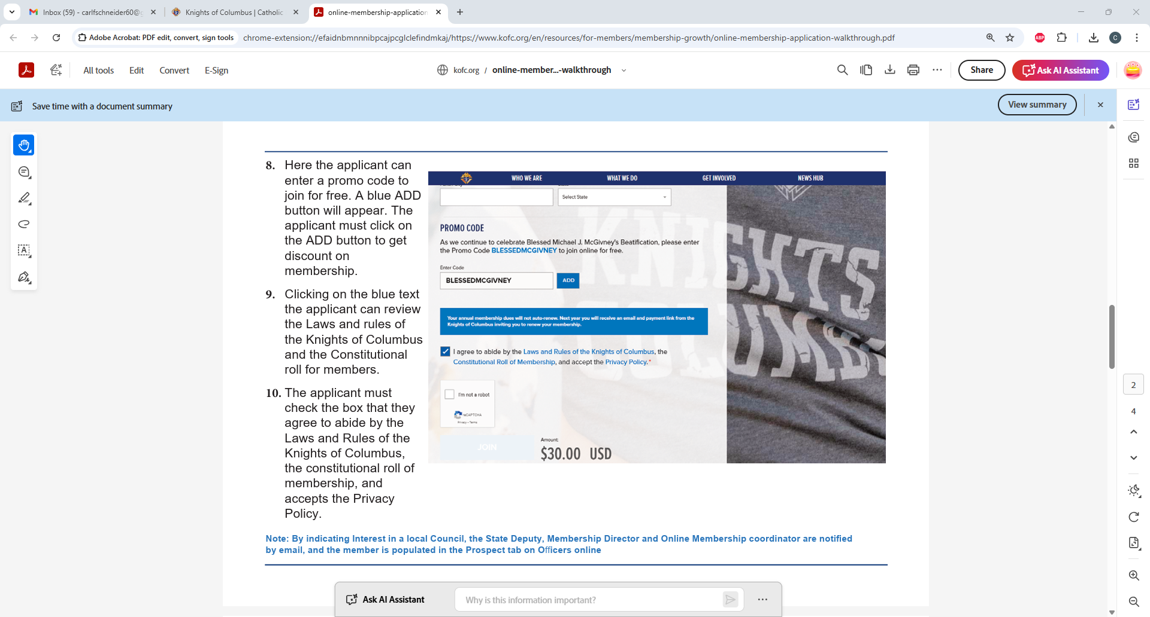
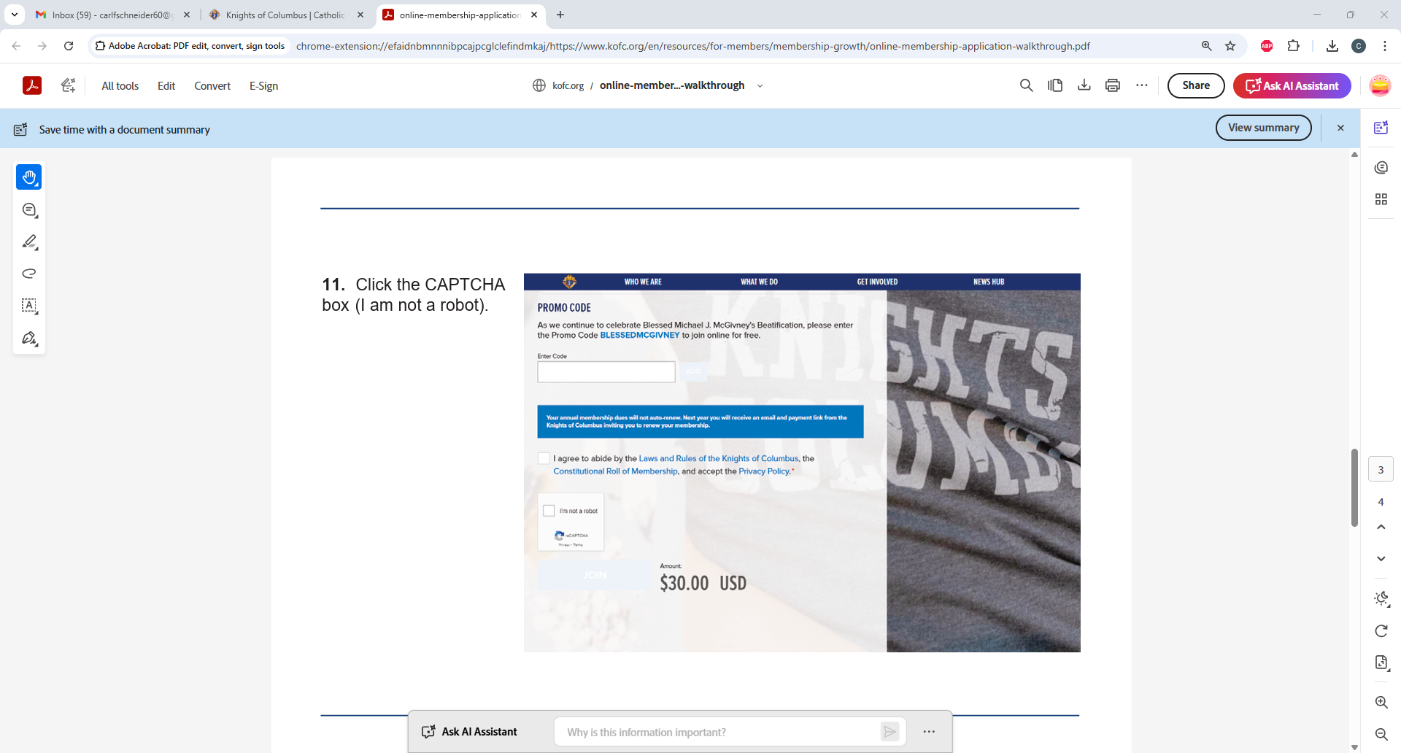

Slide 10
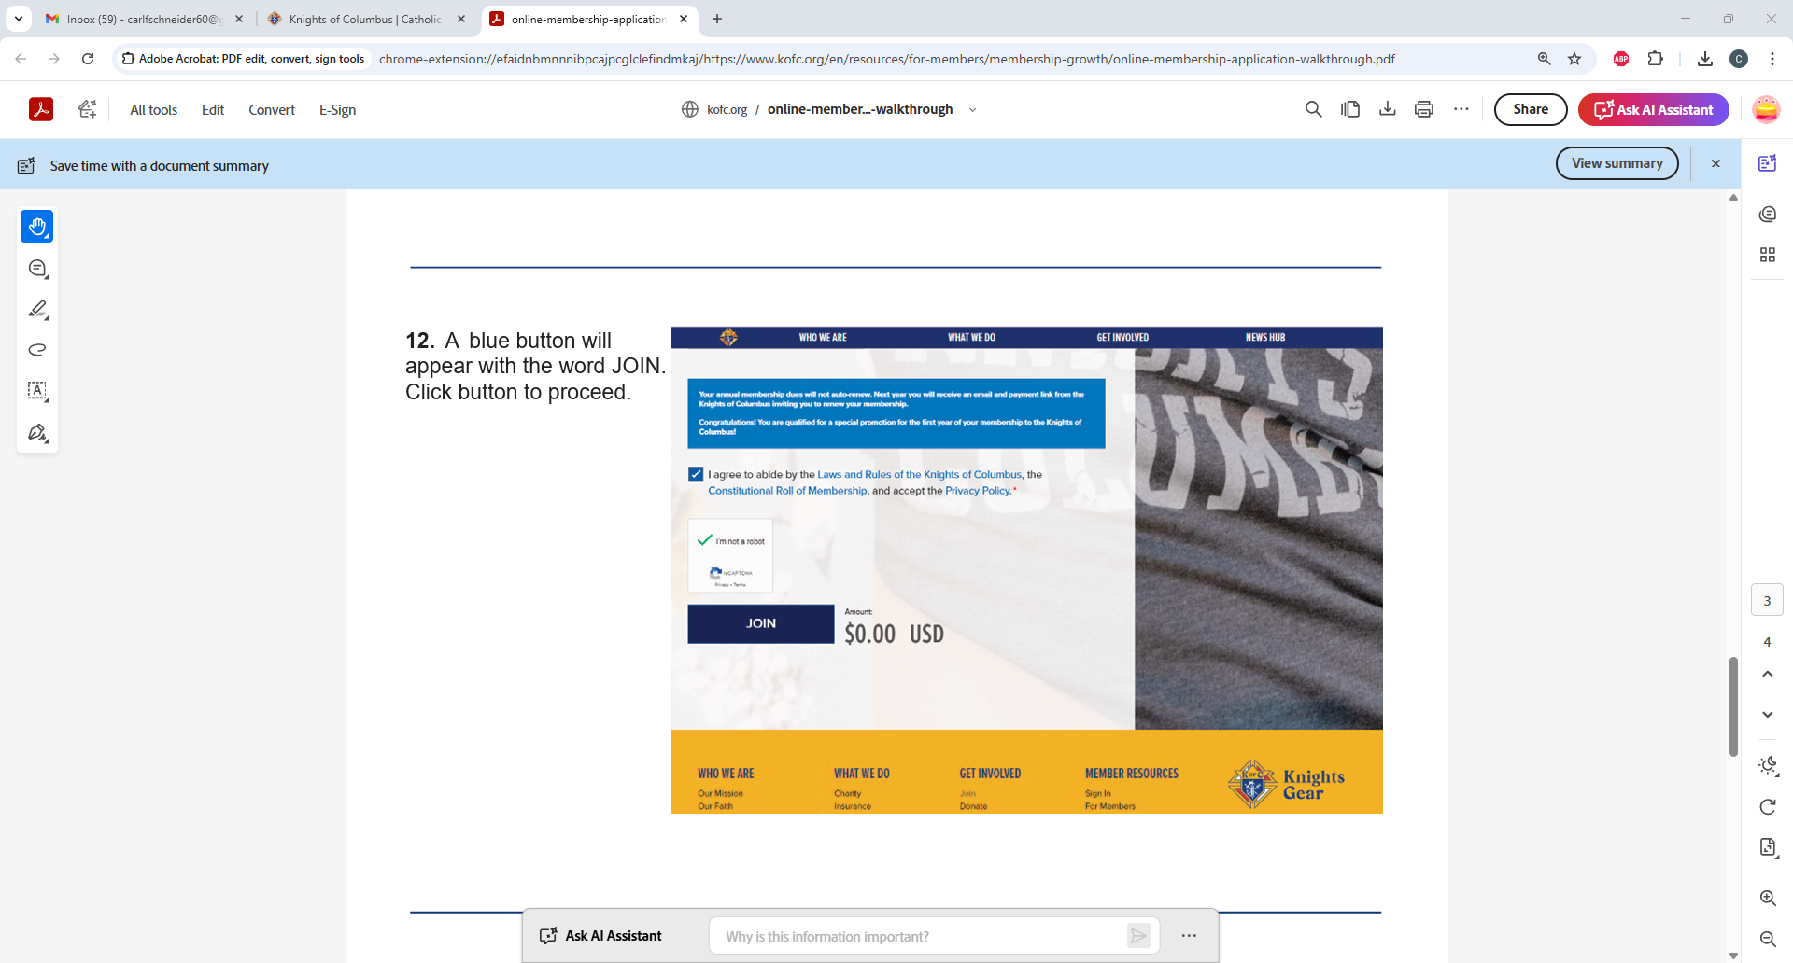

Slide 11
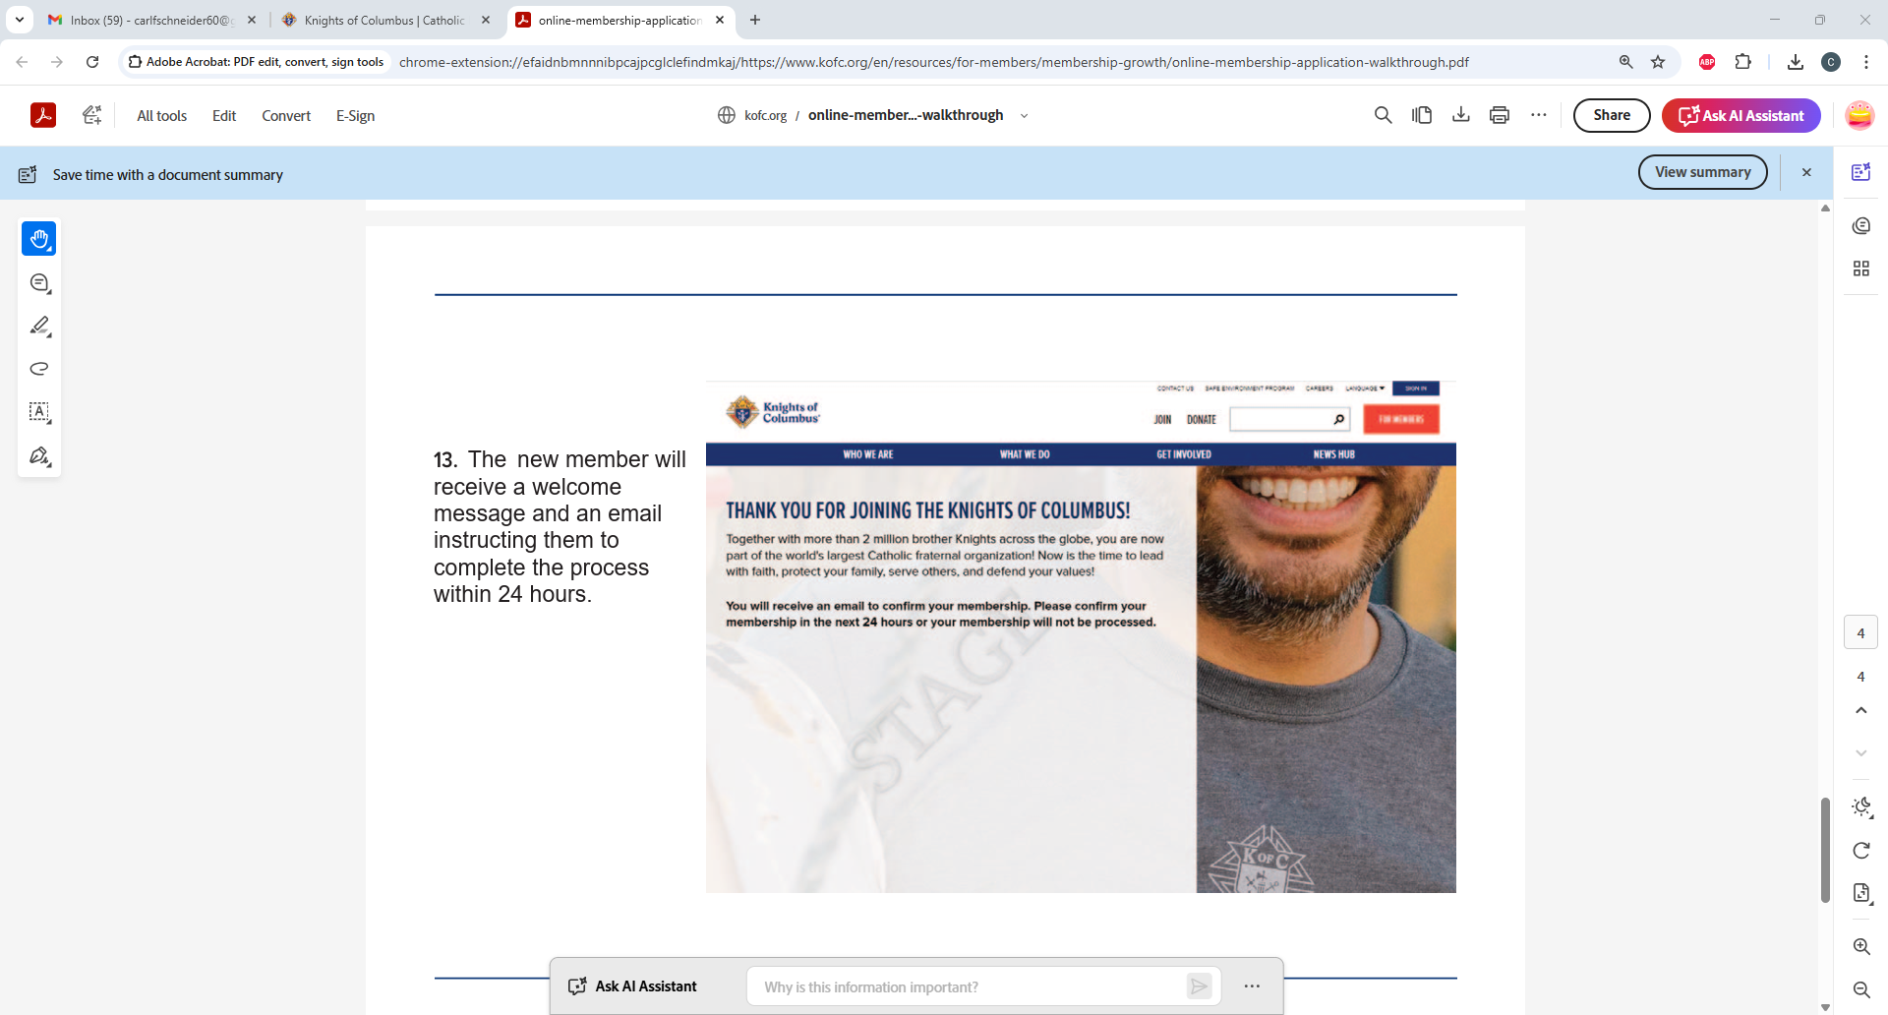

Slide 12
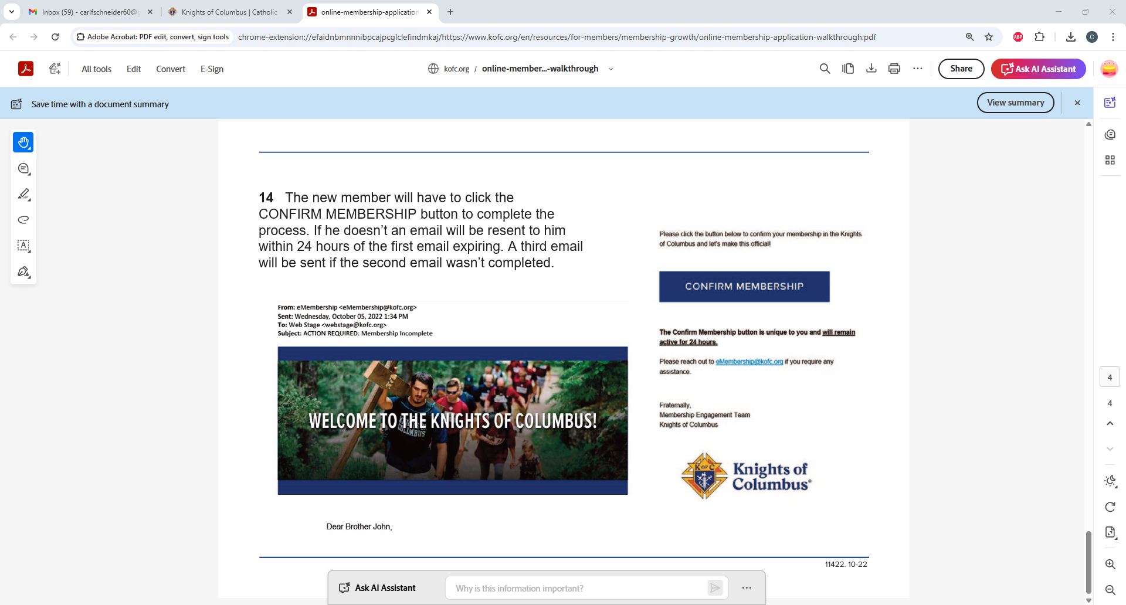

Slide 13
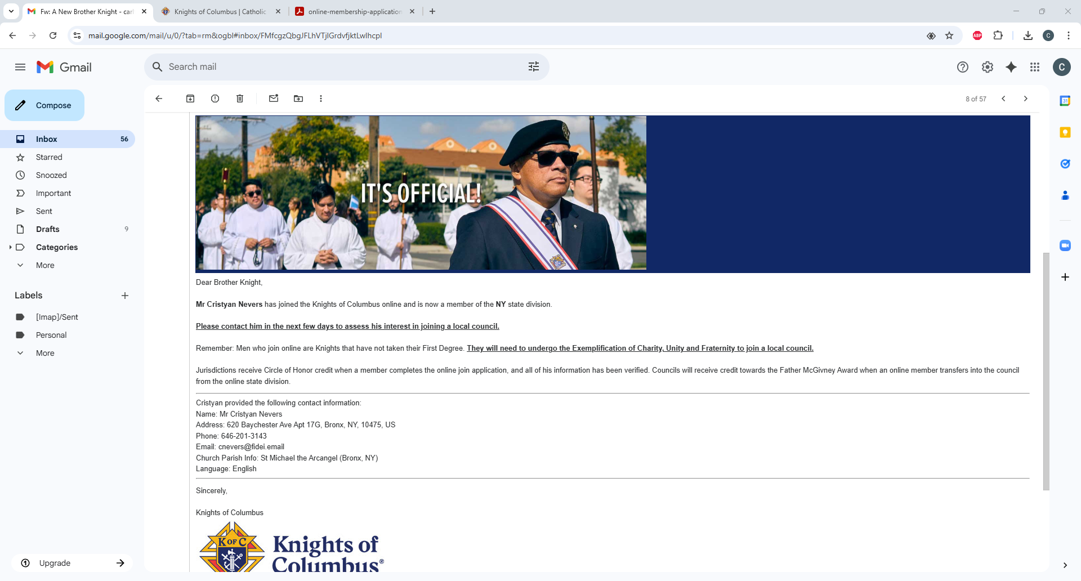

Slide 14
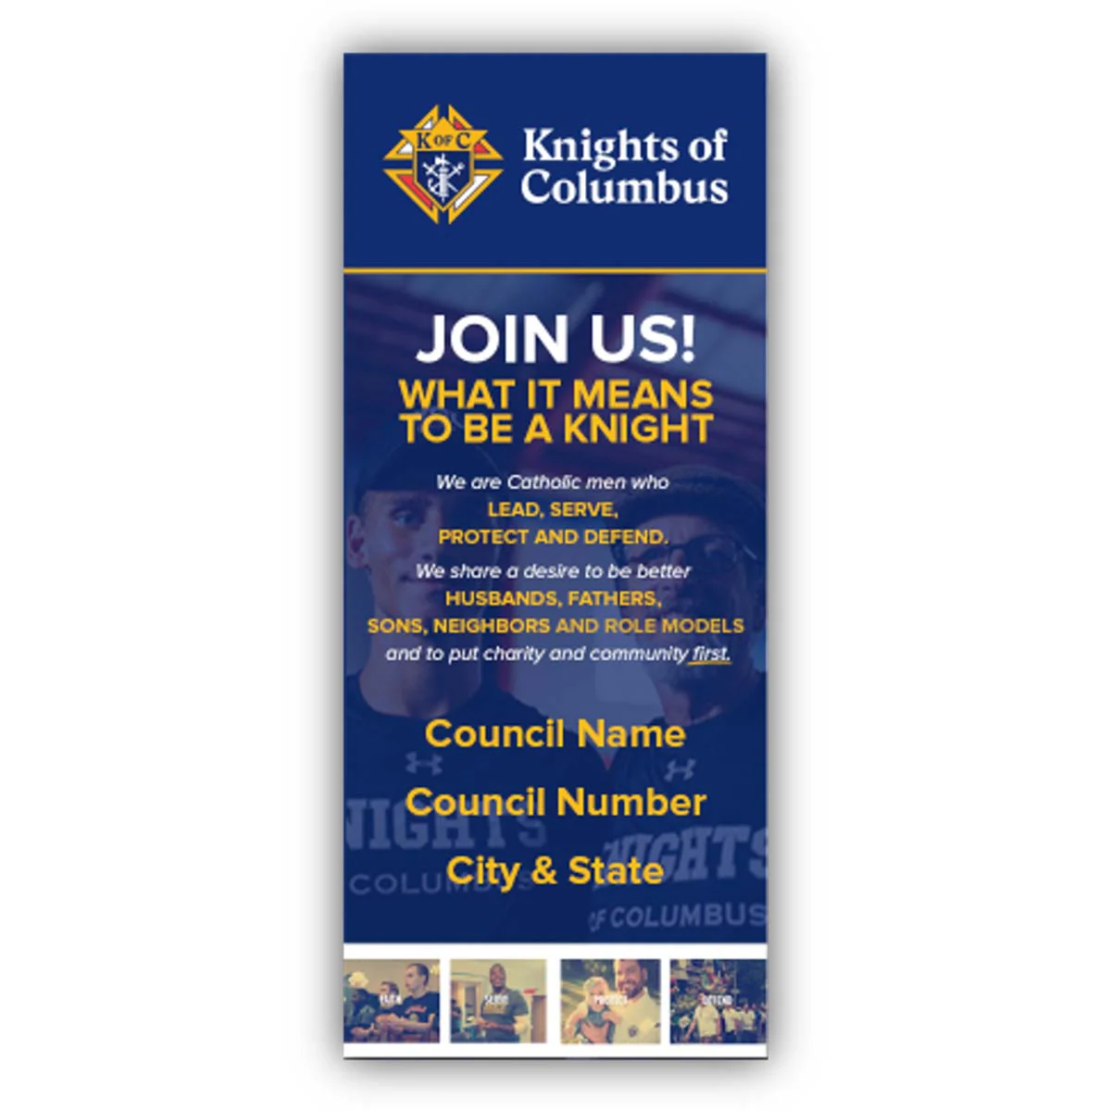

Slide 15


Joined Online
1521
Fraternal Year 2024-25
2406 New Members
Joined
Via Paper
885

Slide 16

Membership Conversion
NYS Council Conversion Rate 66%
Order Wide Conversion Rate 67%

Slide 17

Online Membership Goals for Fraternal Year 2024-25
Have more members join through KofC.org/joinus
It’s the most efficient method of joining the Order.
Convert more online members to council members
The easiest path to Star Council.

